Slide 1


Slide 2
Boost Libraries
Boost is a set of libraries for the C++ programming language that provide support for tasks and structures such as linear algebra, pseudorandom number generation, multithreading, image processing, regular expressions, and unit testing
The Boost community emerged around 1998, when the first version of the standard was released
It has grown continuously since then and now plays a big role in the standardization of C++.
https://theboostcpplibraries.com/

Slide 3
Boost Libraries
Less code -> Real productivity
Less to write
Less to debug
More expressive code
Natural to write
More self-documenting
More likely to be correct the first time

Slide 4
Test-driven development (TDD)
A software development process that relies on the repetition of a very short development cycle:
requirements are turned into very specific test cases, then the software is improved to pass the new tests, only
opposed to software development that allows software to be added that is not proven to meet requirements
Kent Beck (one of the 17 original signatories of the Agile Manifesto) 2003
https://en.wikipedia.org/wiki/Agile_software_development#The_Agile_Manifesto

Slide 5
Test-driven development (TDD)
TDD is a software development process which relies on the repetition of a very short development cycle
Add a test case that defines a desired improvement or new function
Run all tests and see if the new one fails
Write some code to pass the test
Run tests
Refactor code
Repeat
https://en.wikipedia.org/wiki/Test-driven_development

Slide 6
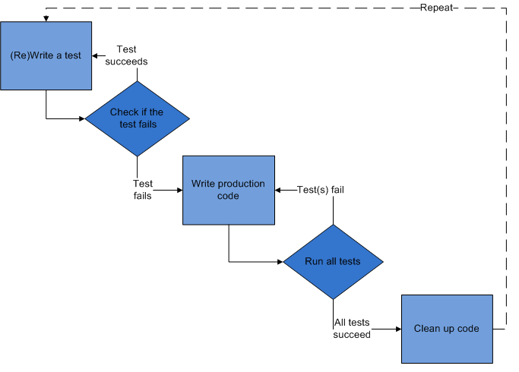
Test-driven development (TDD)
http://alexott.net/en/cpp/CppTestingIntro.html

Slide 7
Software testing
Many different forms of tests:
unit tests:
integration tests: to test if Individual units are combined and functioned as a group.
regression tests: to uncover new software bugs in existing functional
performance tests: to determine how a system performs in terms of responsiveness and stability under a particular workload

Slide 8
Unit testing
Unit testing is a method by which individual units of source code are tested to determine if they are correctly working
A unit is the smallest testable part of an application.
an individual function or procedure

Slide 9
Benefits of unit testing
Facilitate changes: unit tests allow programmers to refactor code at later date, and be sure that code still works correctly
Simplify integration: unit tests may reduce uncertainty in the units, and can be used in a bottom-up testing style approach
Living documentation for the system: easy to gain a basic understanding of implemented Application program interface (API)

Slide 10
How to organize tests
Each test case should test only one thing
A test case should be short
Test should run fast, so it will possible to run it very often
Each test should work independent of other test
Tests should NOT be dependent on the order of their execution

Slide 11
Test methods
How should a test program report errors? Displaying an error message would be one possible way
requires inspection of the program’s output after each run to determine if an error exists.
Human inspection of output message is time consuming and unreliable
Unit testing frameworks are designed to automate those tasks
if( something_bad_detected )
std::cout << “Something bad has been detected” << std::endl;

Slide 12
Test methods: Unit testing frameworks
To simplify development of unit tests, unit test frameworks are usually used
Almost any programming language has several unit testing frameworks

Slide 13
Unit testing frameworks in C++
There are many unit testing frameworks for C++
Boost.Test, Google C++ Testing Framework, etc, etc, etc!
Boost.Test
Suitable for novice and advanced users
Allows organization of test cases into test suites
Test cases can be registered automatically and/or manually

Slide 14
Unit testing frameworks in C++
Boost.Test
Fixtures (initialization and cleanup of resources)
Large number of assertion/checkers
Exceptions
Equal, not equal, greater, less
Explicit fail/success
Floating point numbers comparison etc.

Slide 15
Testing tools/Checkers
WARN
produces warning message check failed, but error counter does not increase and test case continues
CHECK
reports error and increases error counter when check fails, but test case continues
REQUIRE
similar to CHECK, but it is not used to report “fatal” errors.

Slide 16
Testing tools/Checkers
Expression examples
If the check fails, Boost.Test will report the line in the source code where this occurred and what condition was specified.
BOOST_WARN( sizeof(int) ==sizeof(short));
BOOST_CHECK(i == 1);
BOOST_REQUIRE (i > 5);
BOOST_REQUIRE(‘h’, s[0]);

Slide 17
Shift register
Shift register consists of an arrangement of flip-flops and are important in applications involving the storage and transfer data in a digital system, it is a type of sequential logic circuit, mainly for storage of digital data.
They are a group of flip-flops connected in a chain so that the output from one flip-flop becomes the input of the next flip-flop.

Slide 18
Shift register: LFSR
Linear Feedback Shift Register (LFSR) is popularly known as Pseudo-random number generator.
The random numbers repeat itself after 2^n-1 clock cycles (where n is the number of bits in LFSR)

Slide 19
Shift register
Starting with 1000, the output stream is
1000 1001 1010 1111 000
Repeat every 2⁴ – 1 bit
The seed is the key
⊕
INPUT |  | OUTPUT
A | B | A XOR B
0 | 0 | 0
0 | 1 | 1
1 | 0 | 1
1 | 1 | 0
1
0
0
0

Slide 20
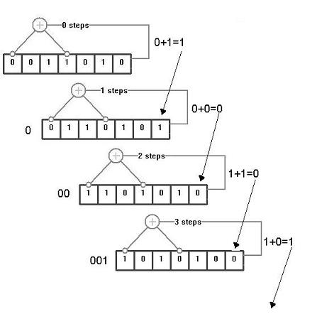
Shift register

Slide 21
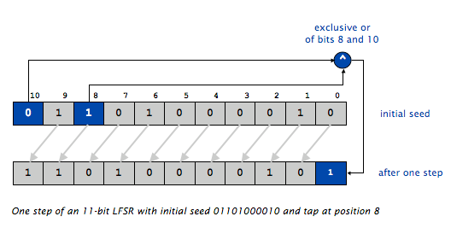
Shift register

Slide 22
Shift register
APPLICATIONS
As a counters
Random number generators
Error detection and correction
Cryptography
Jamming
Test-pattern generation

